Slide 1
Introduction to Bioinformatics
Dr. Justin P. Whalley, Ph.D.
Computational Biology/Bioinformatics Interest Group

Slide 2
What is the smallest step you can do to be called a ‘Bioinformatician’ (or any other field)?

Slide 3
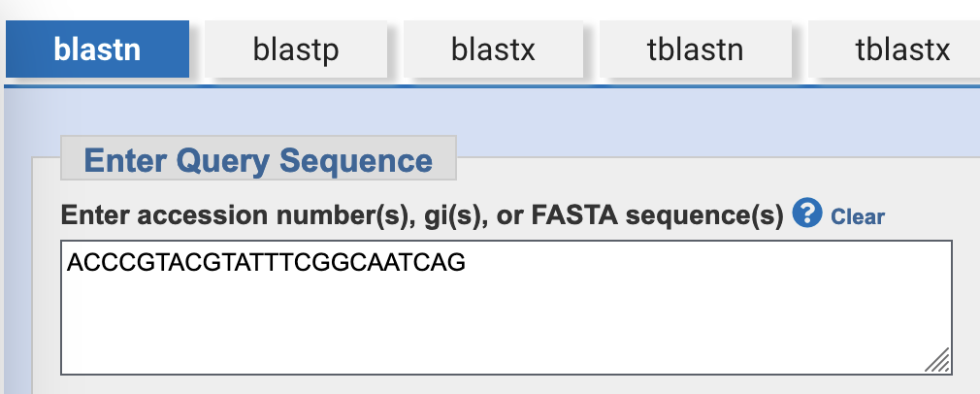
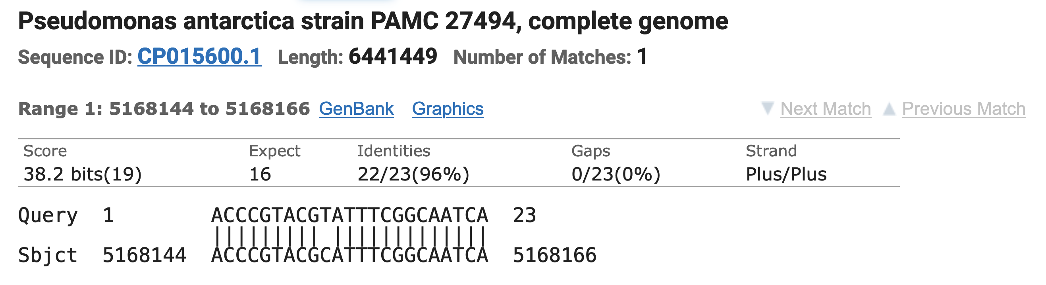
Matching a sequence of letters to another
https://blast.ncbi.nlm.nih.gov/Blast.cgi

Slide 4
Matching sequences across species

Slide 5
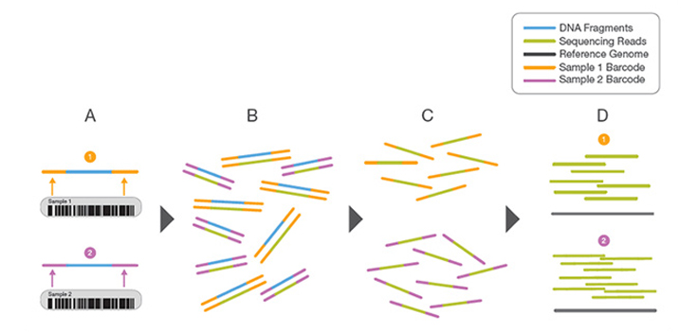
Multiplexing
https://www.illumina.com/techniques/sequencing/ngs-library-prep/multiplexing.html

Slide 6
Raw sequencing data
@SRR001666.1 071112_SLXA-EAS1_s_7:5:1:817:345 length=36
GGGTGATGGCCGCTGCCGATGGCGTCNAATCCCACC
+
IIIIIIIIIIIIIIIIIIIIIIIIIIIIII9IG9IC
@SRR001666.2 071112_SLXA-EAS1_s_7:5:1:801:338 length=36
GTTCAGGGATACGACGTTTGTATTTTAAGAATCTGA
+
IIIIIIIIIIIIIIIIIIIIIIIIIIIIIIII6IBI

Slide 7
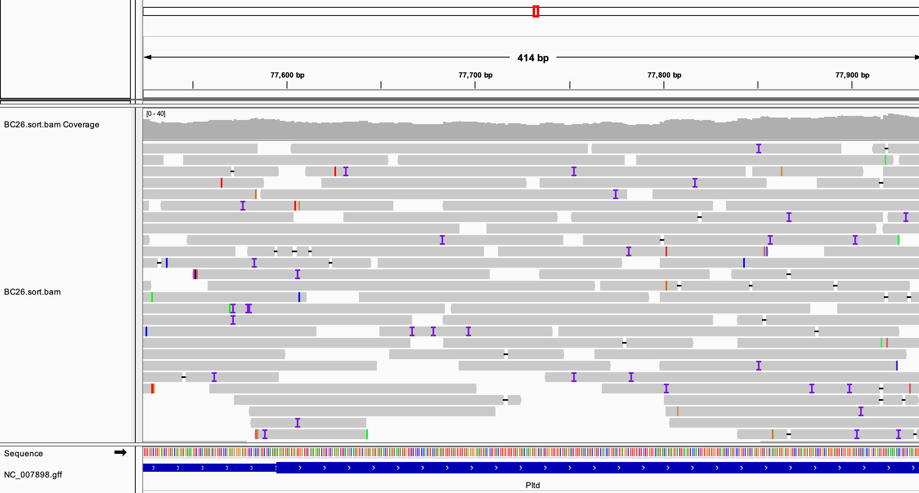
Matching reads to a reference
https://blast.ncbi.nlm.nih.gov/Blast.cgi

Slide 8
Genetics
DNA

Slide 9
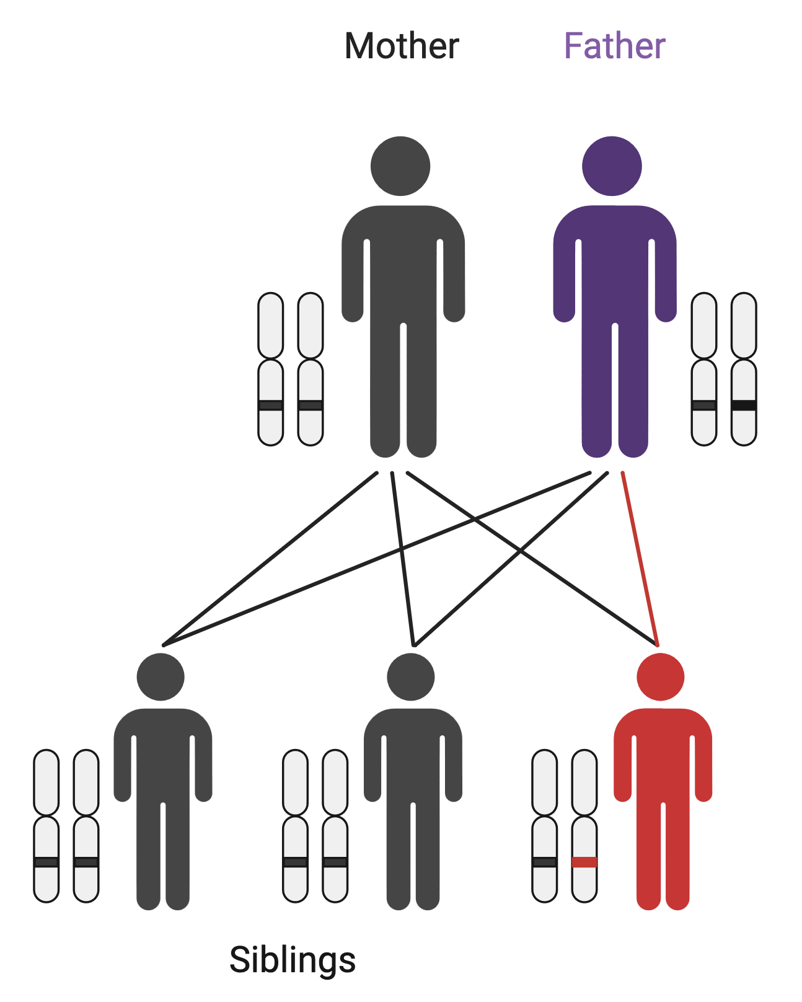

Rare diseases – de novo mutations
Mother: ATTCG
Father: ATTCG
Child: ATTGG
Sibling: ATTCG

Slide 10
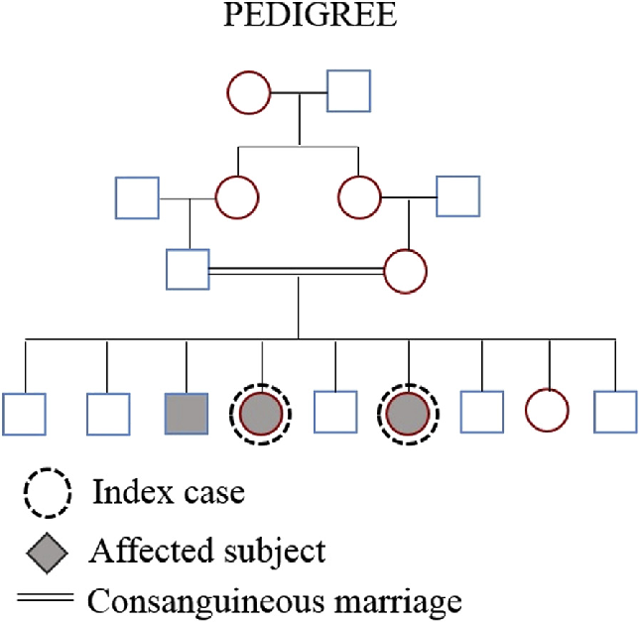
Rare diseases – consanguinity
Soares, D. et al. (2016). Pyle disease (metaphyseal dysplasia) presenting in two adult sisters. Radiology Case Reports. 11. 10.1016/j.radcr.2016.10.003.

Slide 11
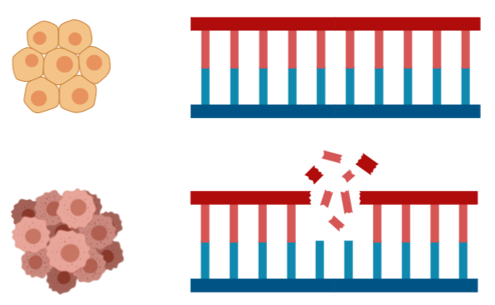

Cancer genetics
Sequence tumour sample and normal sample from the same patient.
Normal: GCTTAGCT
Cancer: GC_ _ _GCT

Slide 12
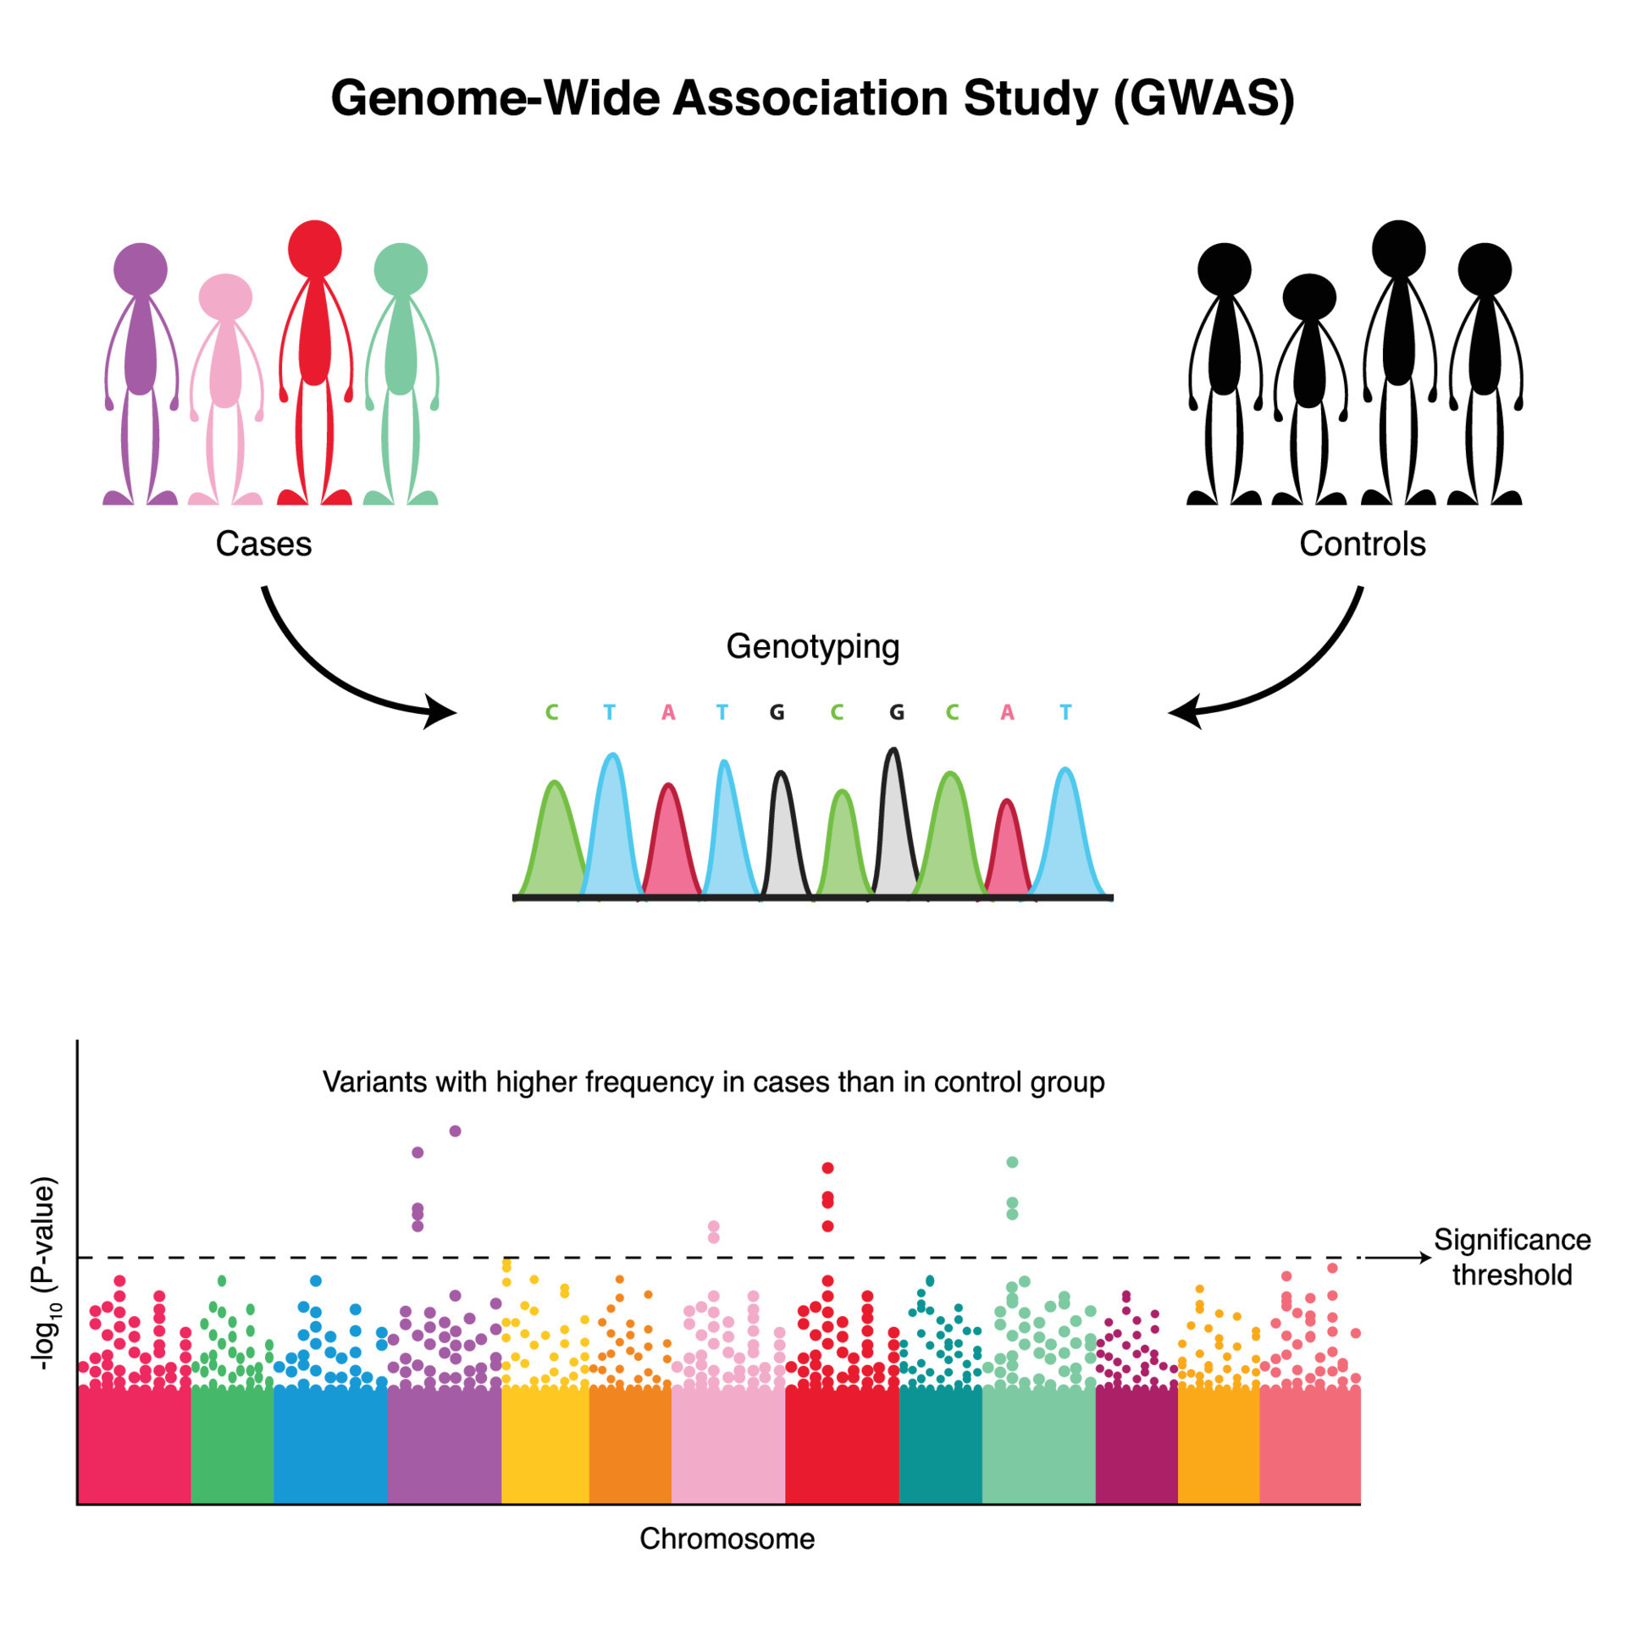
Complex traits / Common diseases
https://www.vecteezy.com/vector-art/7508599-genome-wide-association-study-diagram

Slide 13
Functional Genomics
DNA -> RNA

Slide 14
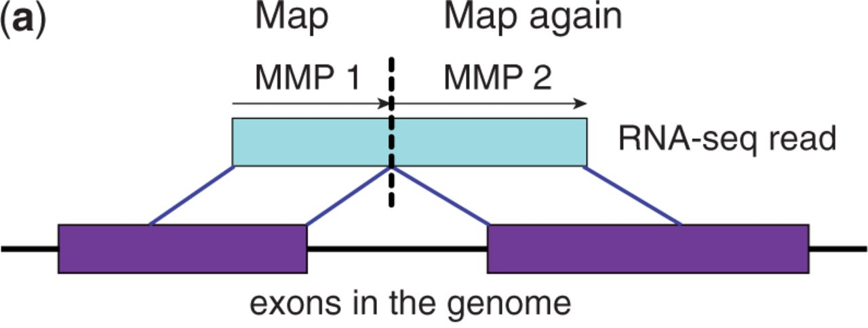

Mapping RNA sequences to the genome
Bioinformatics, Volume 29, Issue 1, January 2013, Pages 15–21, https://doi.org/10.1093/bioinformatics/bts635
The content of this slide may be subject to copyright: please see the slide notes for details.

Slide 15
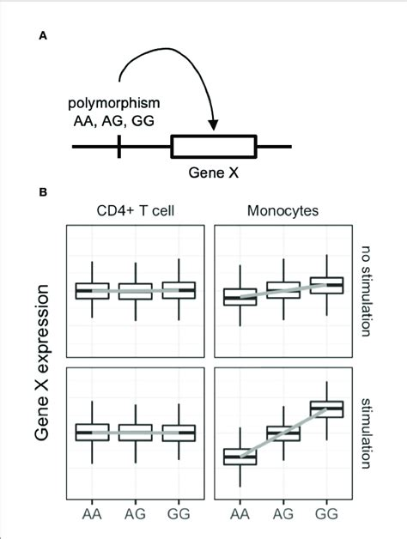
Genotyping and Gene expression: expression Quantitive Trait Loci
Nagafuchi, Y. et al. (2022). Lessons From Transcriptome Analysis of Autoimmune Diseases. Frontiers in Immunology. 13. 857269. 10.3389/fimmu.2022.857269.

Slide 16
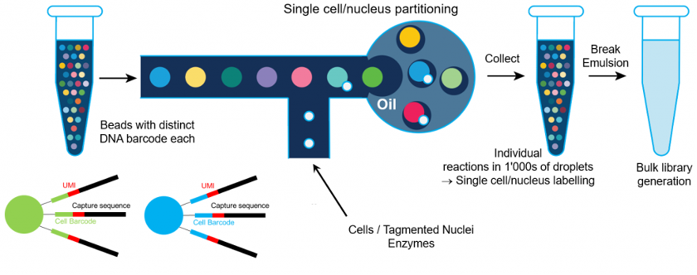
Single cell RNA-seq
Drop-seq from 10X Genomics

Slide 17
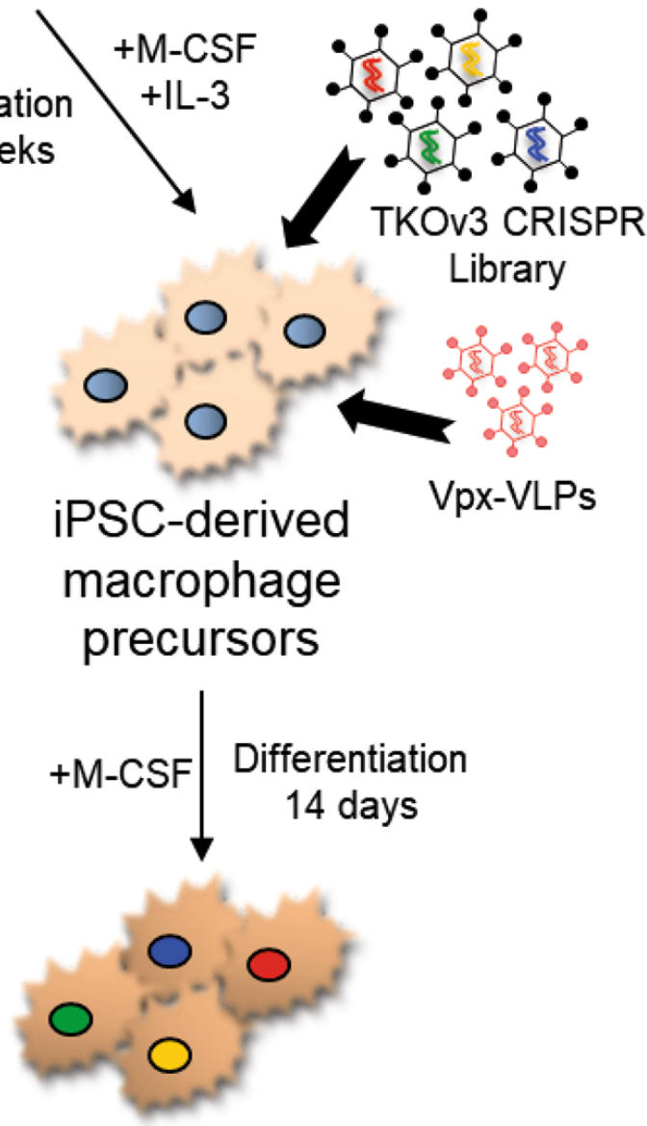
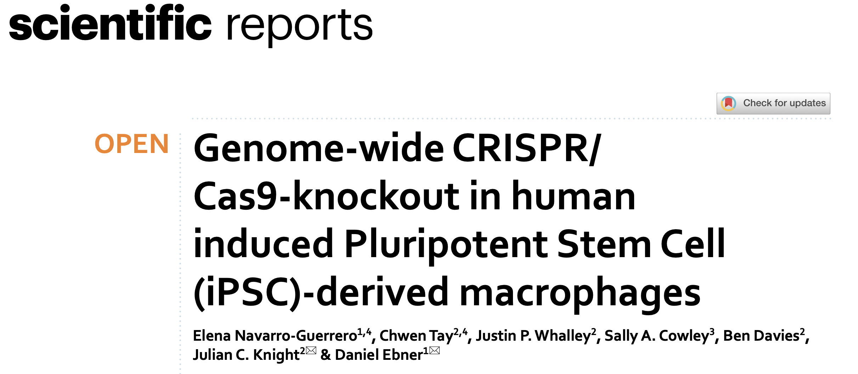
Which genes are important?

Slide 18
Environmental effects
Epigenetics
DNA -> RNA

Slide 19
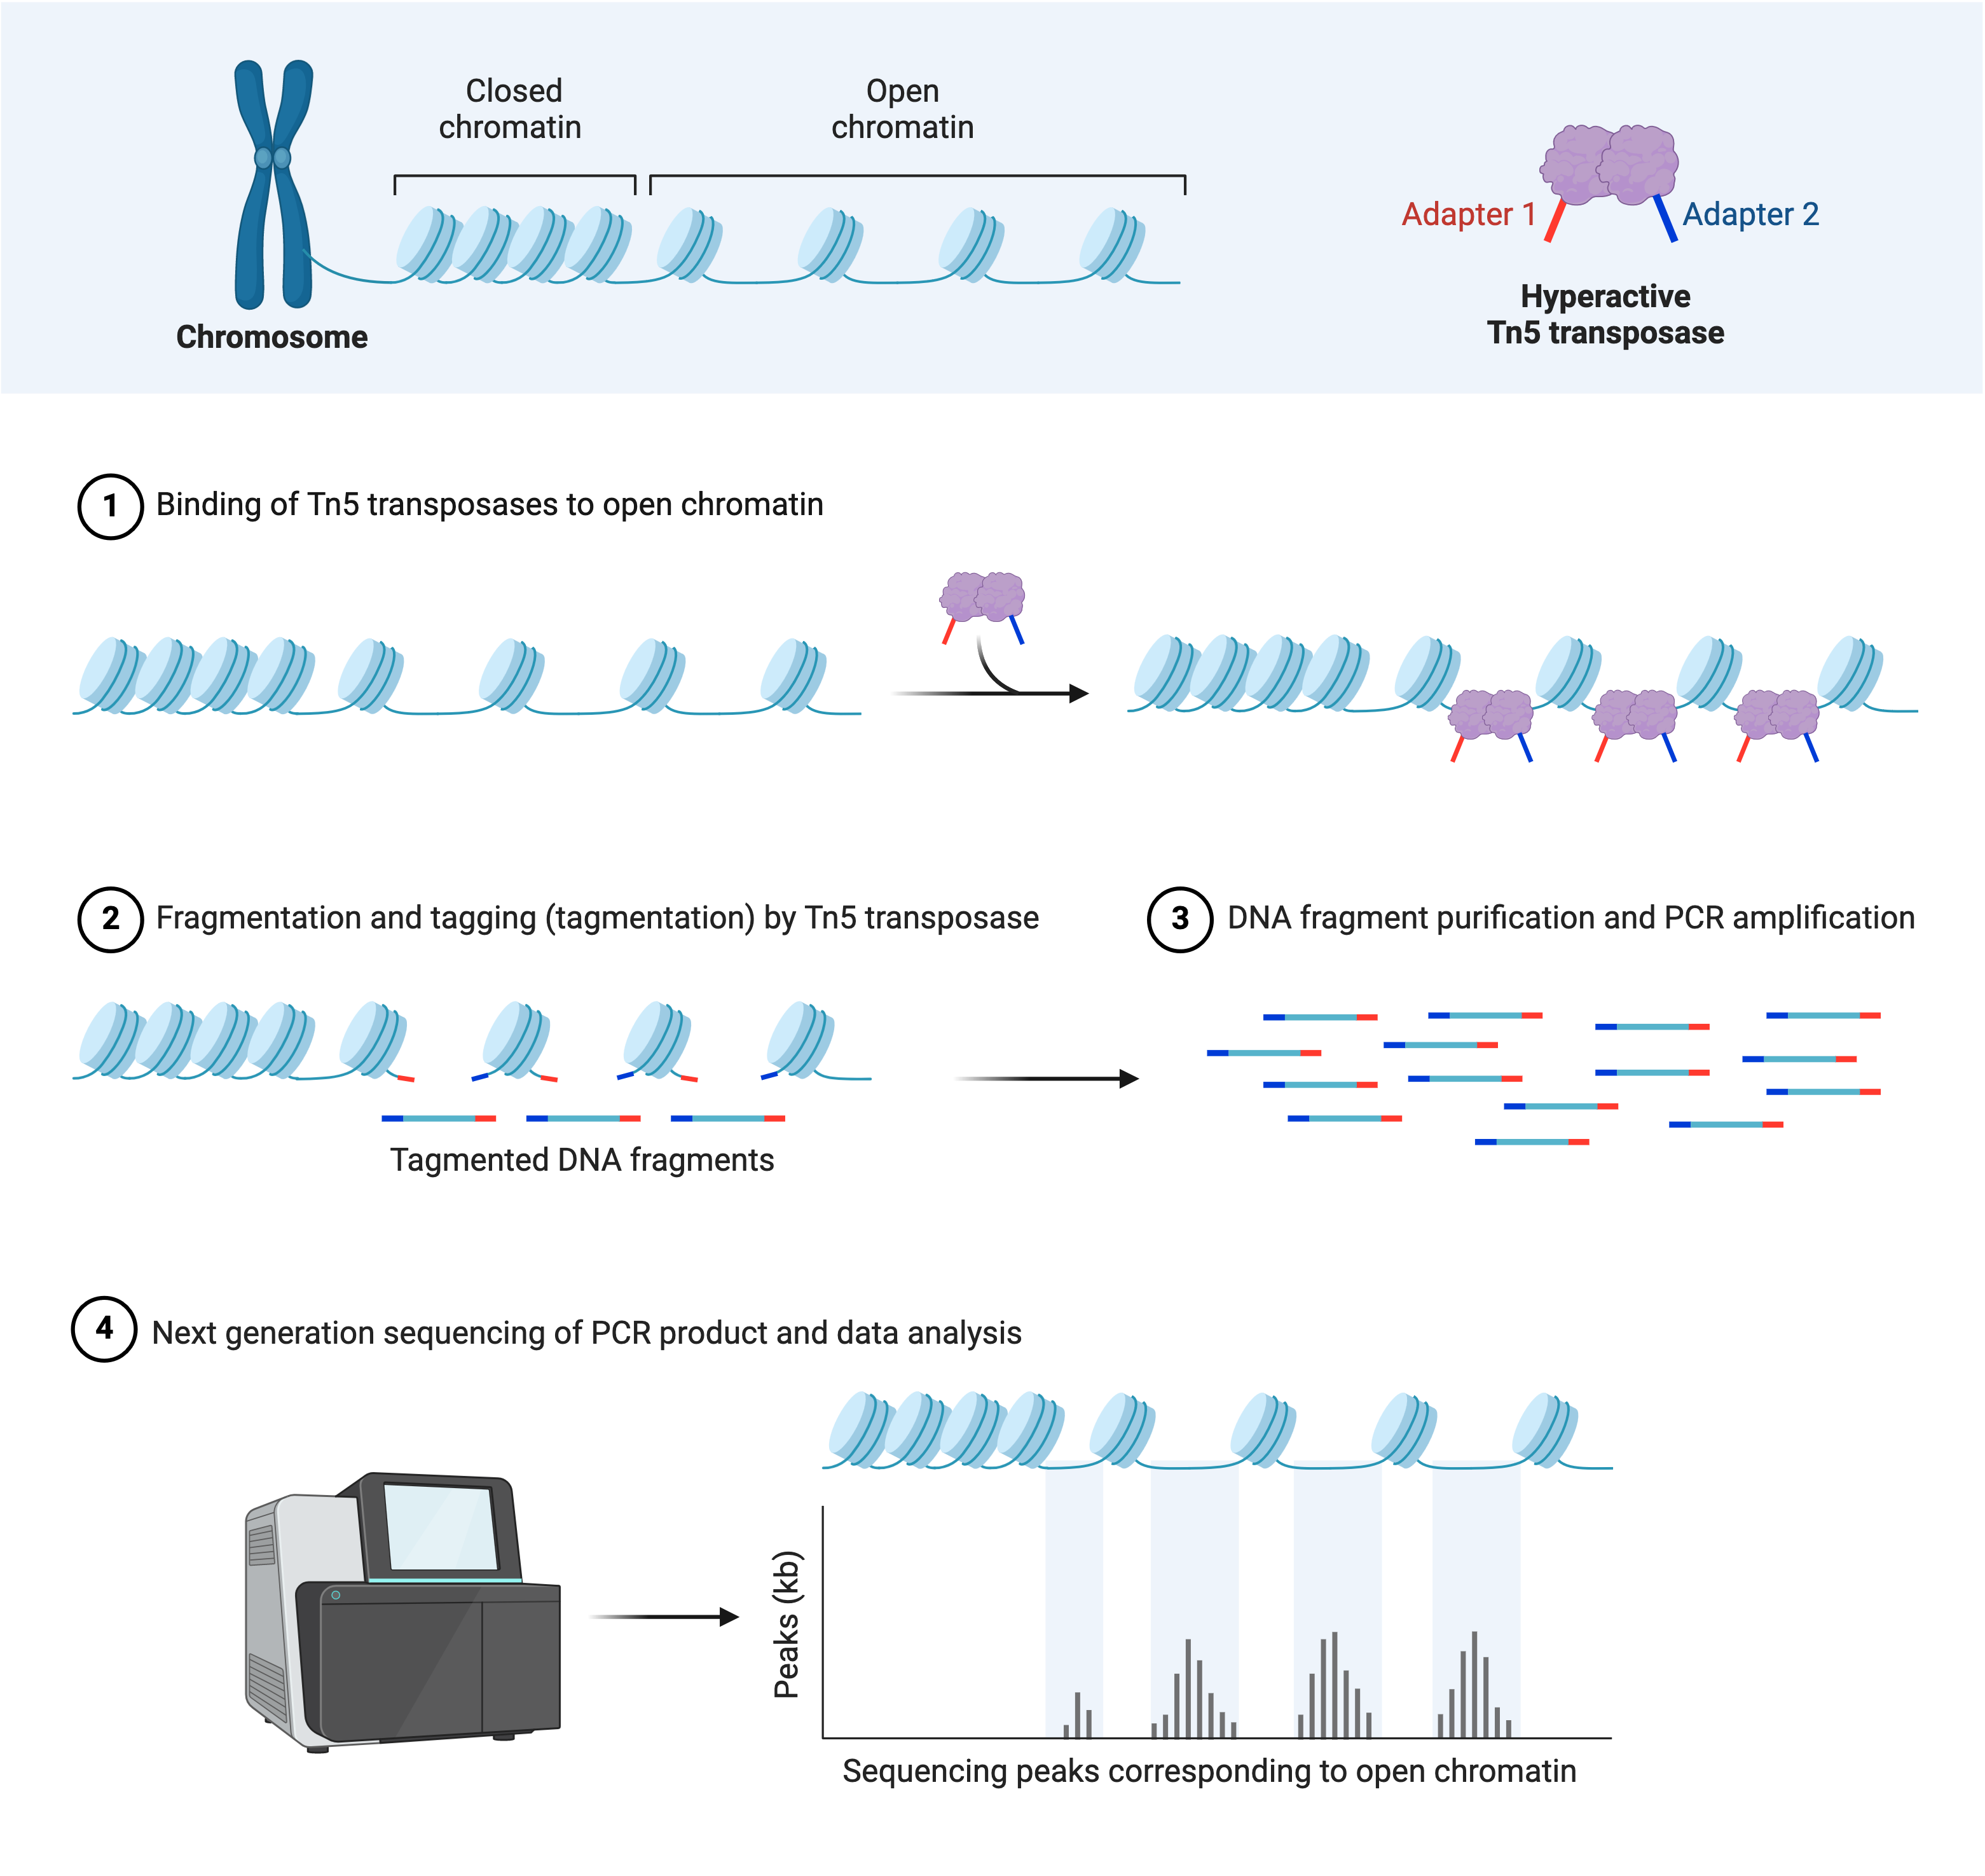
ATAC-seq: Assay for Transposase-Accessible Chromatin
Created with BioRender.com

Slide 20
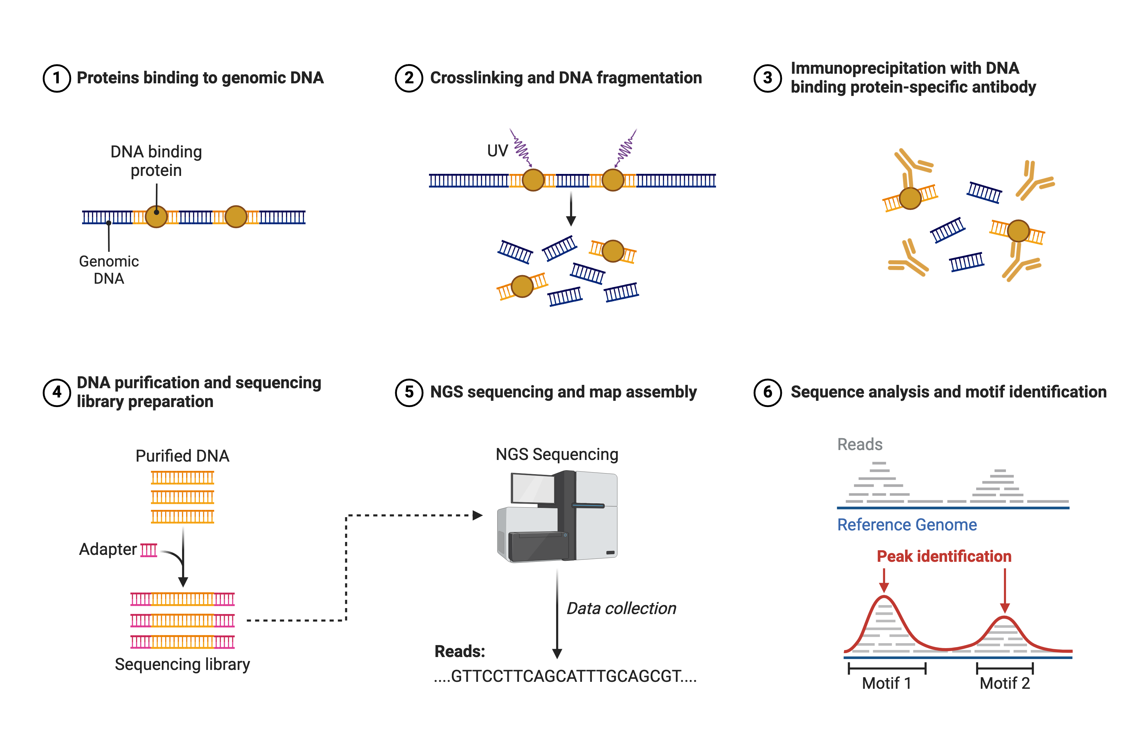
ChIP-seq
Created with BioRender.com

Slide 21
Analysis of the data
Epigenetics
DNA -> RNA -> Proteins

Slide 22
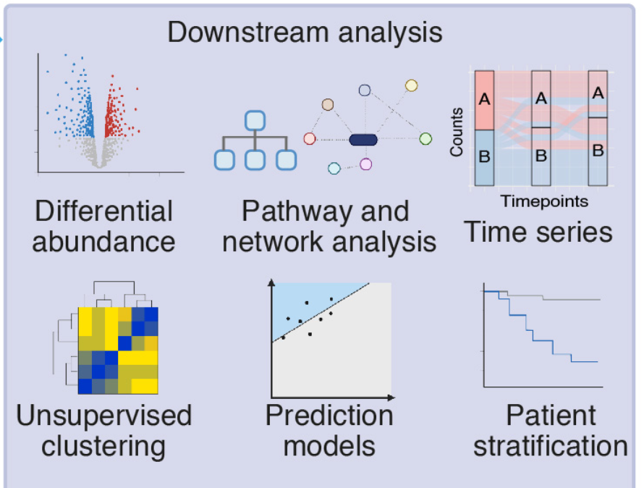
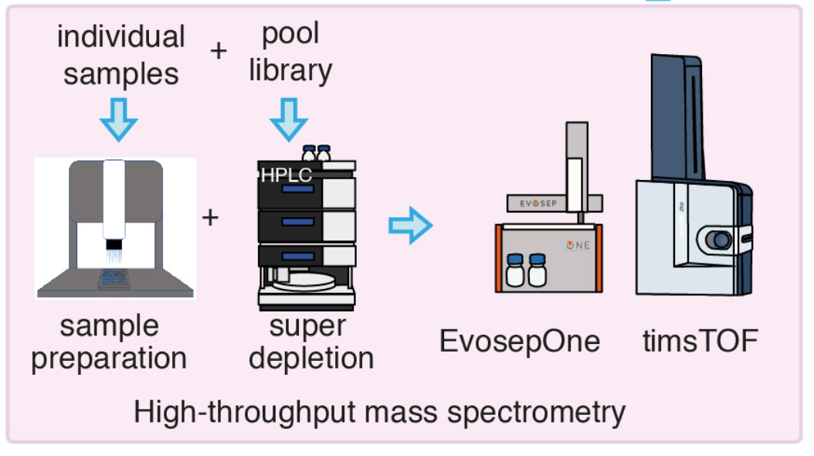
Analysis of Proteins

Slide 23
Other data
Epigenetics
DNA -> RNA -> Proteins
Metabalomics
Cellular data Lipidomics
Imaging Data
Phenotypes

Slide 24
‘omic data versus phenotypic data
Power law
Normal distribution

Slide 25
Normalization of data

Slide 26
Normalization of data

Slide 27
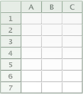
Sanity check of the data
400 donors
15,000 genes
Naive
IFNγ
Fairfax et al. Innate immune activity conditions the effect of regulatory variants upon monocyte
gene expression. Science, 2014.
Treatment
LPS 2h
LPS 24h

Slide 28
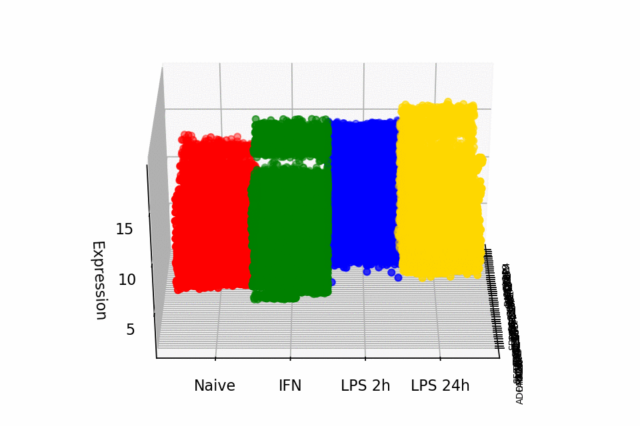
Sanity check of the data

Slide 29
Dimension reduction – Gene Expression

Slide 30
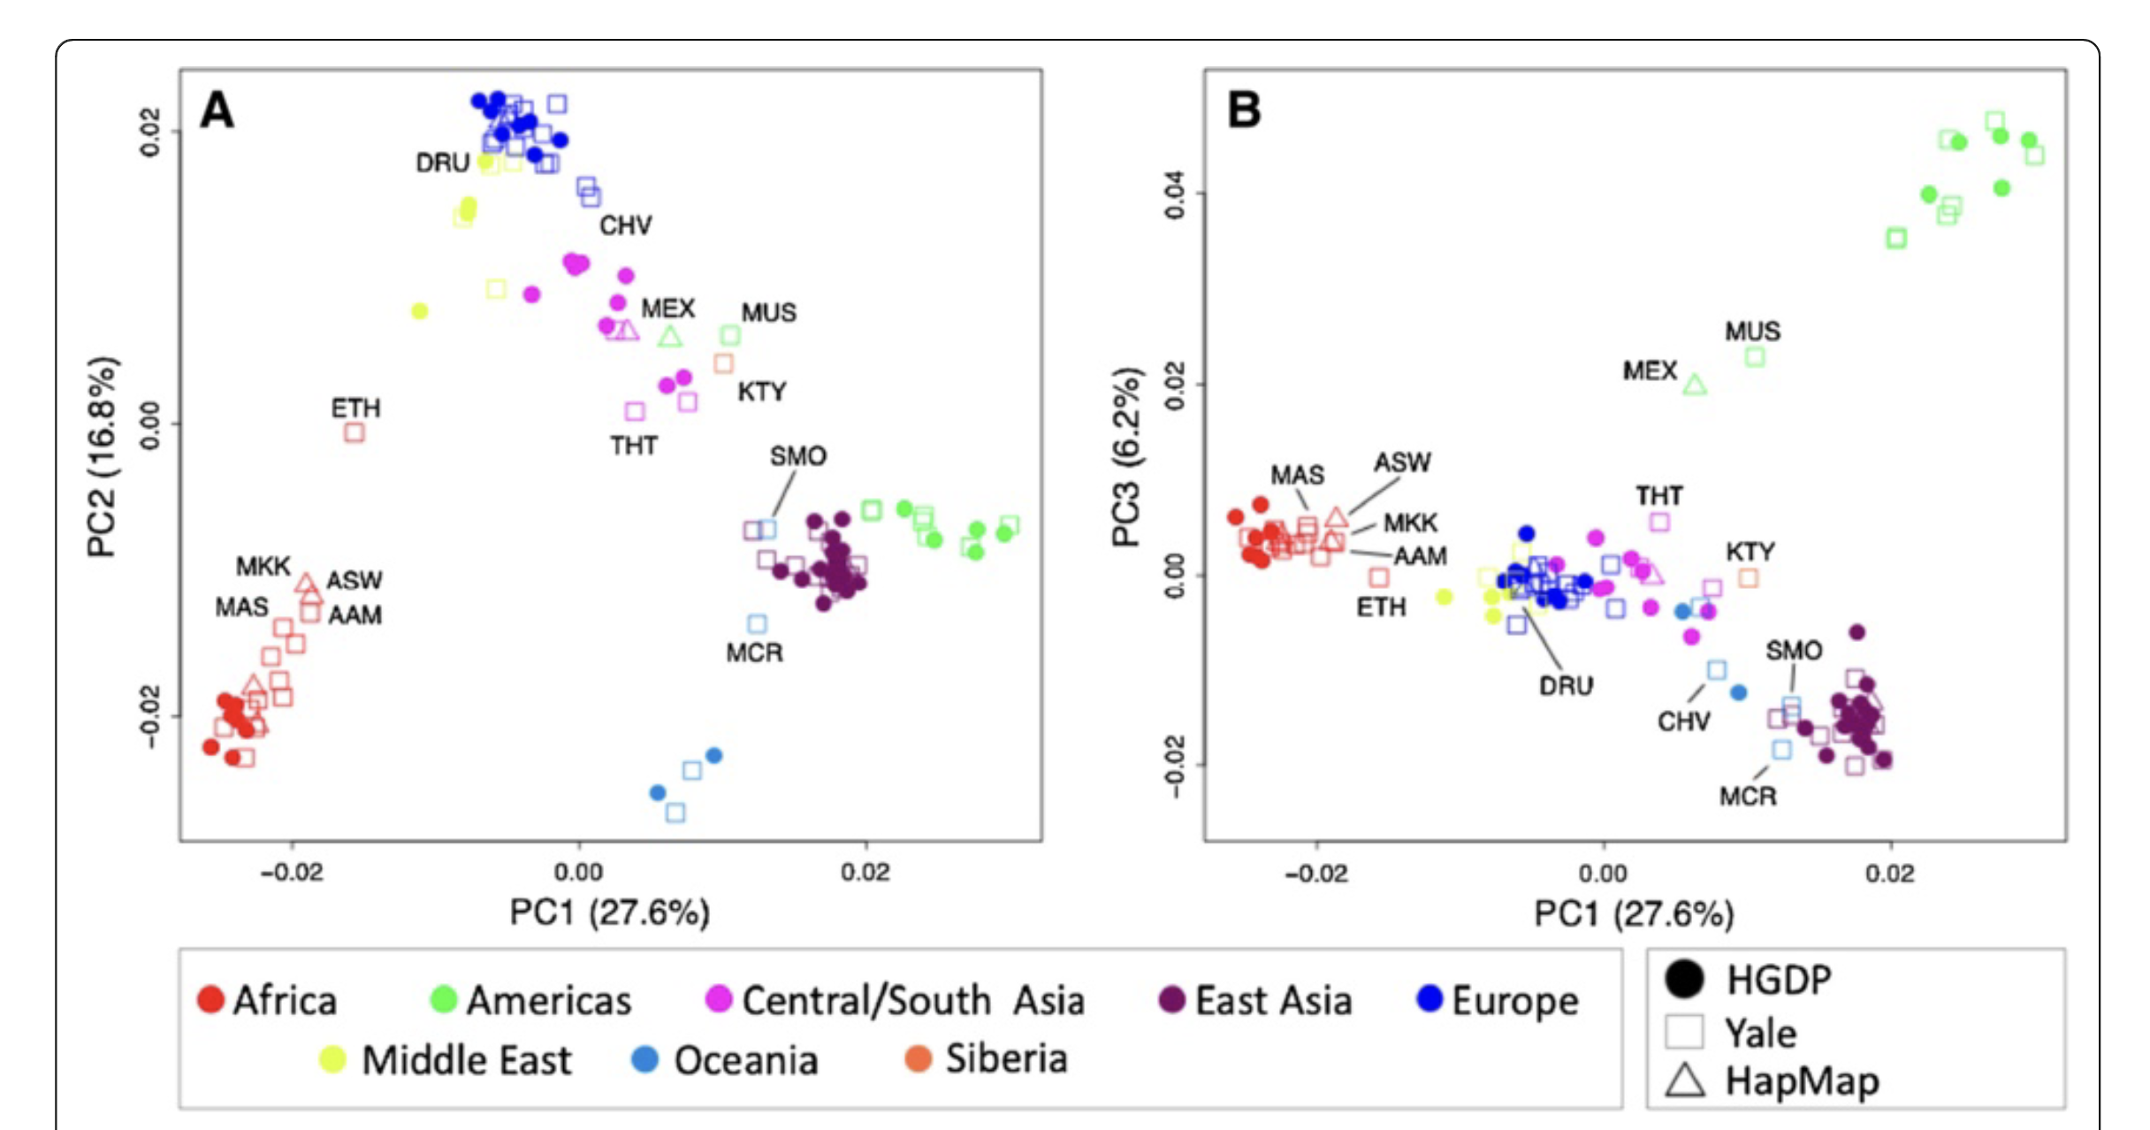
Dimension reduction – Genetics
Nievergelt et al. Investigative Genetics 2013, 4:13

Slide 31
Dimension reduction

Slide 32
Normalization of data

Slide 33
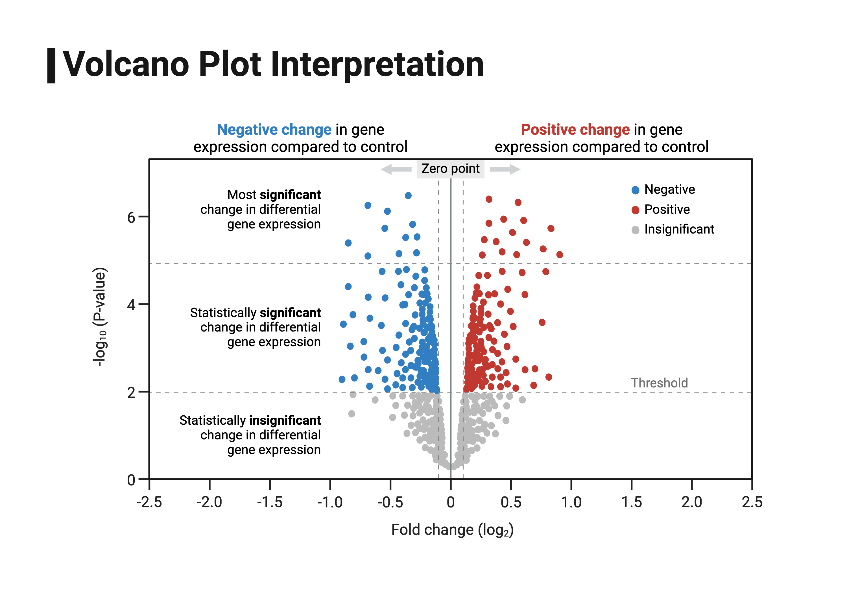
Which genes/proteins are important
Biorender

Slide 34
Which pathways are important?

Slide 35
Integrating different levels of data

Slide 36
Thank you!
CB/BIG COMMITTEE
Faculty Member: Dr. Marc Glucksman
Faculty Member: Dr. Judith Potashkin
3rd Year PhD student: Elise Webber
2nd Year PhD student: Carolina Caloba
1st Year PhD student: Sam Gatesy
Postdoc: Dr. Renuka Ramachandra

Slide 37
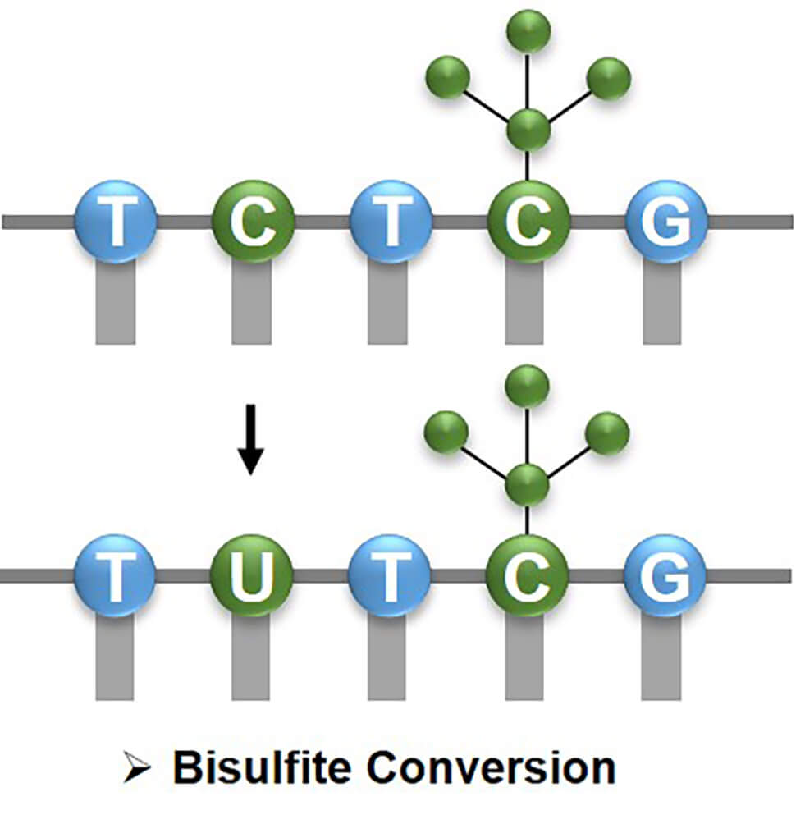
Methylation
https://www.creativebiomart.net/epigenetics/wp-content/themes/epigenetics

